Slide 1
Chapter 14 WebSphere Application Server
WebSphere Application Server on z/OS
(Based on Version 5)

Slide 2
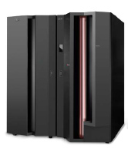
Chapter objectives
Be able to:
List the six qualities of the J2EE Application model
Give three reasons for running WebSphere Application Server under z/OS
Name three connectors to CICS, DB2, and IMS

Slide 3
Key terms in this chapter
cell
CR
CGI
EIS
JMX
J2EE
SR
cluster
node

Slide 4
Introduction to Web applications on z/OS
Past:
  Many applications are tied to z/OS (CICS, DB2)
  New developments made on other platforms
Now:
  Integrate both on z/OS

Slide 5
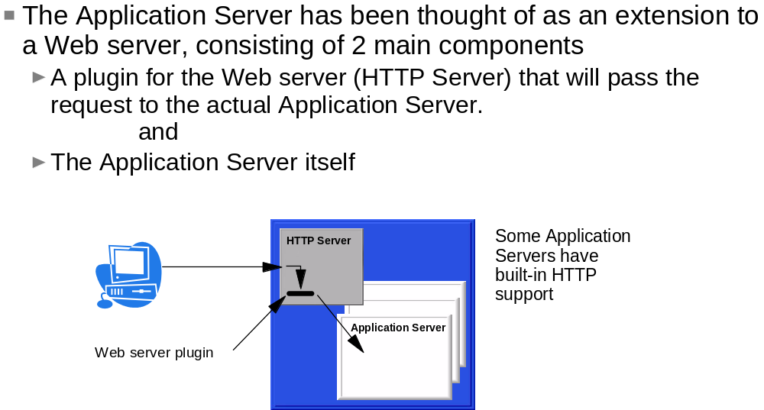
Extending the web server

Slide 6
J2EE Application Model in z/OS
Same as on other platforms, following SDK:
Functional
Reliable
Usable
Efficient
Maintainable
Portable

Slide 7
Running WebSphere Application Server for z/OS
Basics of WebSphere on z/OS
Consolidation of workloads
WebSphere for z/OS Security
Continuous availability
Performance

Slide 8
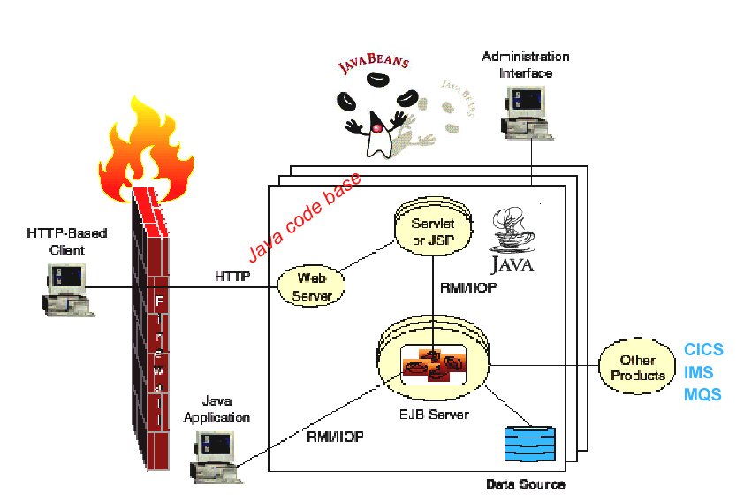
What is an Application Server

Slide 9
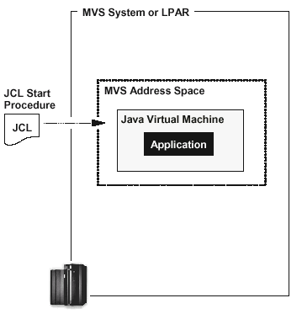
J2EE Applications execute in
MVS Address Space(s)
z/OS Services
UNIX SYSTEM SERVICES

Slide 10
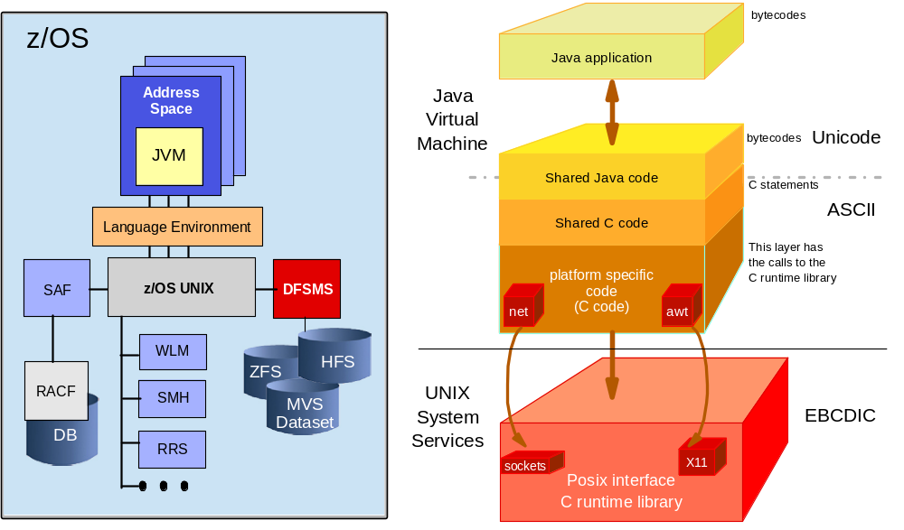
Java Virtual Machine in z/OS

Slide 11
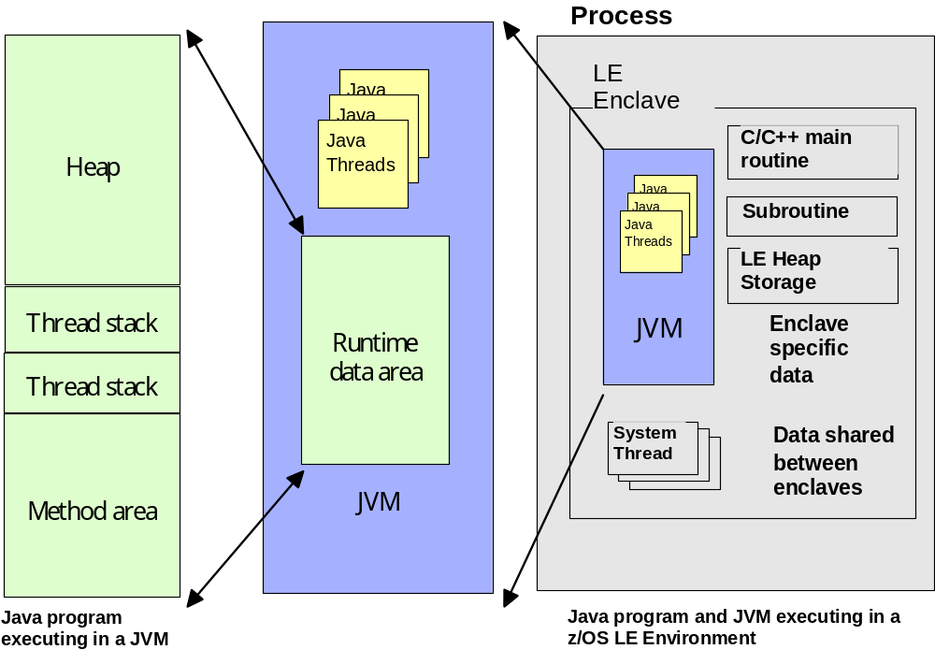
JVM in z/OS LE

Slide 12
Enterprise Application Packaging
J2EE
Application
Application
Installed
.EAR file
DD
RAR
EJB
Web
Client
Module
Module
Module
.JAR file
.WAR file
.JAR file
Enterprise
EJB
Servlet
JSP
HTML,
Web
Client
Client
Bean
DD
GIF, etc.
DD
Class
DD
DD = Deployment Descriptor

Slide 13
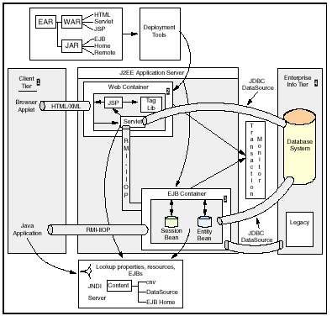
J2EE Enterprise Application Architecture
1.
2.
3.
5.
4.

Slide 14
WebSphere Application Server for z/OS
Organization based on concepts:
Servers
Nodes (and Node Agents): a logical grouping of WebSphere-managed servers
Cells: a grouping of Nodes
Within the address spaces, concept of CONTAINER

Slide 15
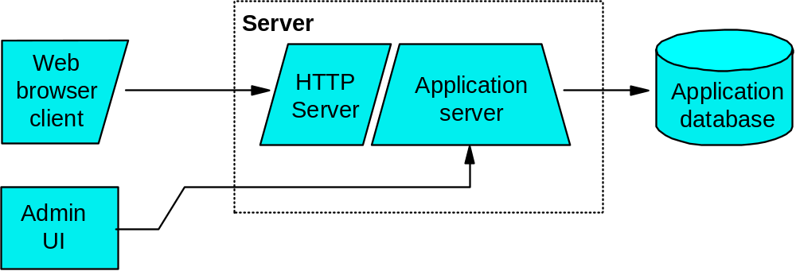
Basic Model

Slide 16
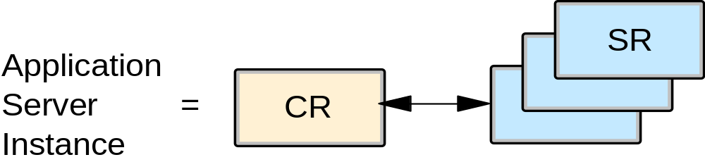
WebSphere Application Server for z/OS
Conform Software Development Kit (SDK)
Interoperates with other subsystems
CR = Controller Region
SR = Servant Region

Slide 17
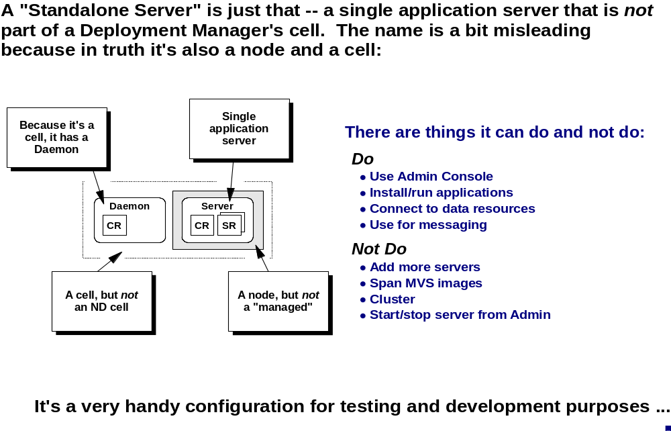
What is a “Standalone” Server

Slide 18
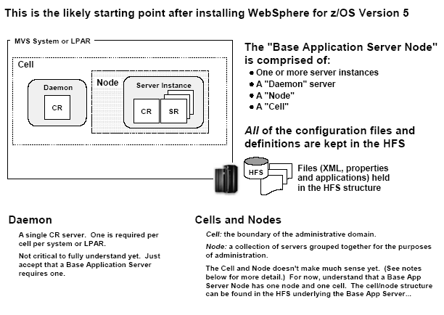
WebSphere Base Application Server

Slide 19
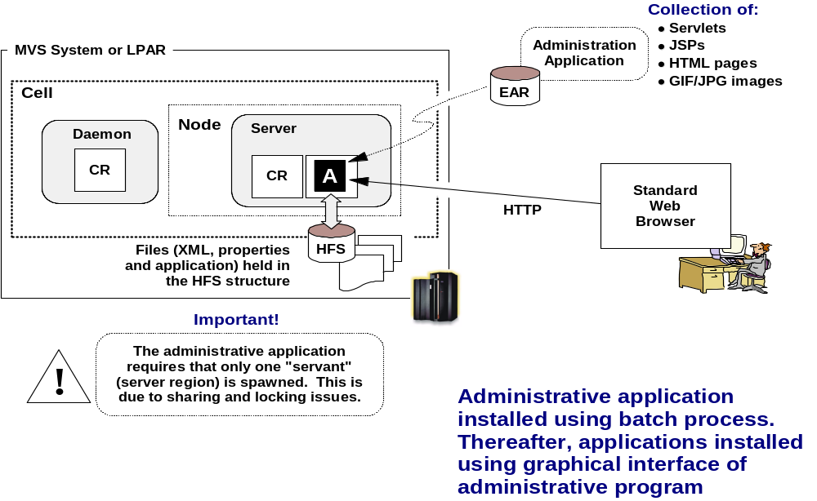
Administering a Base Application Server

Slide 20
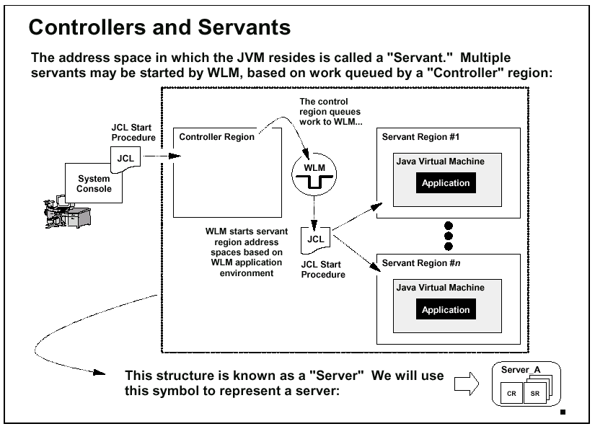
Address Space Relationships

Slide 21
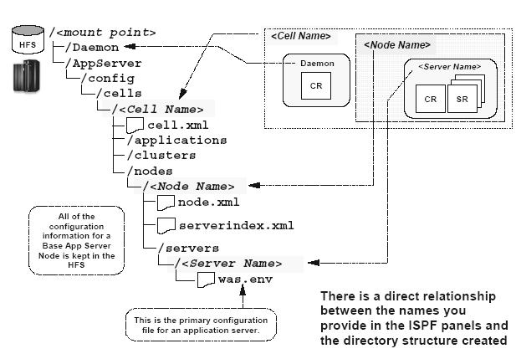
HFS under the Base Application Server Node

Slide 22
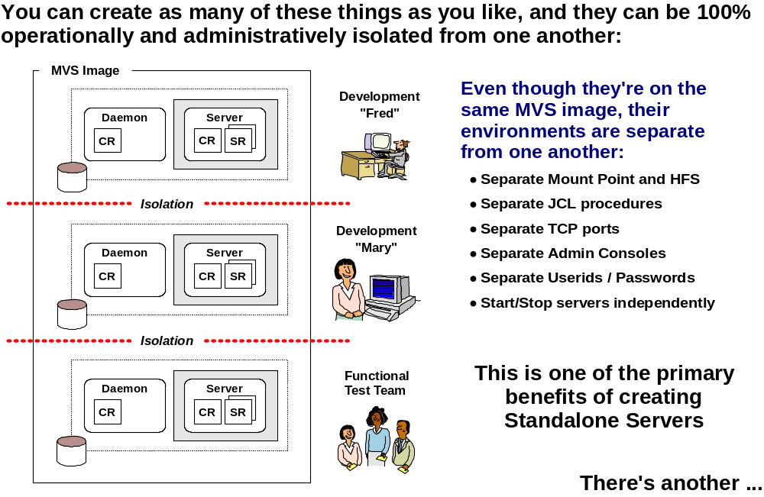
Small, Separate Environments

Slide 23
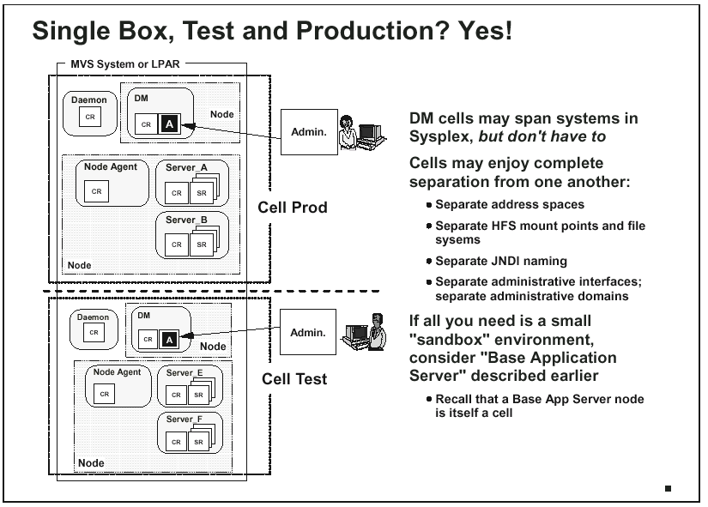

Slide 24
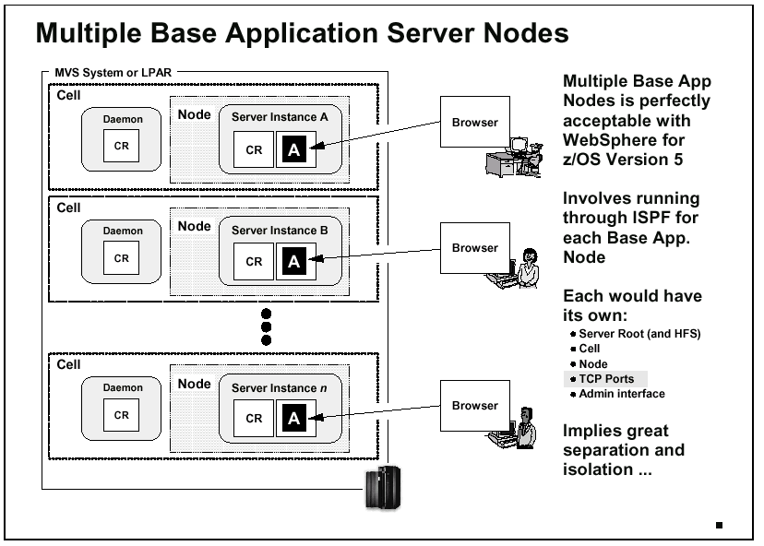

Slide 25
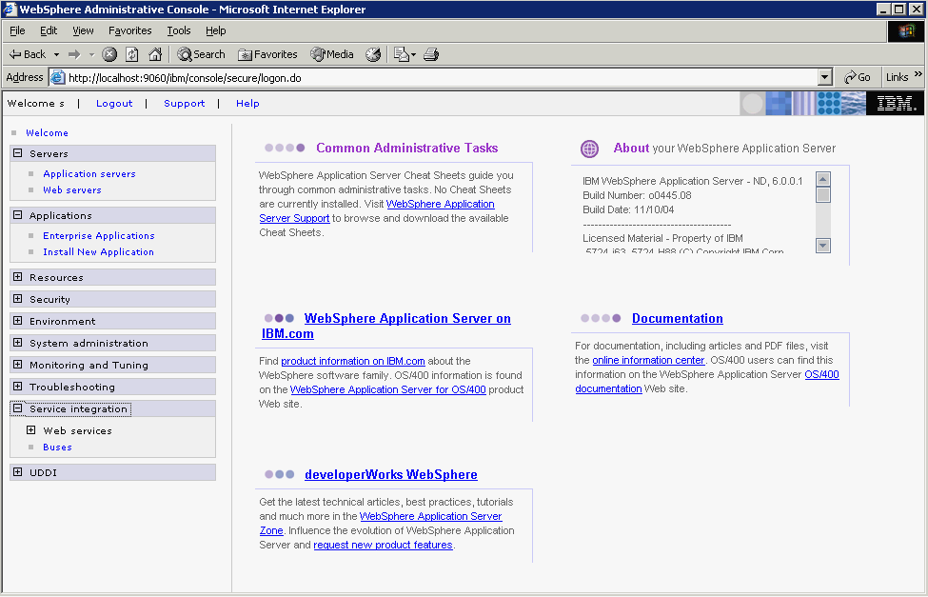
New Administrative Console Look and Feel

Slide 26
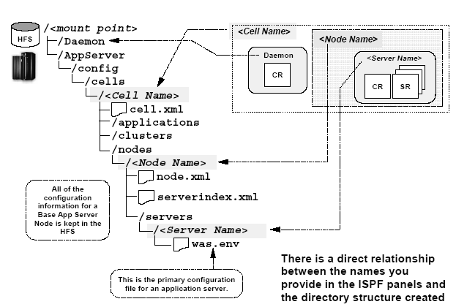
HFS under a Base Application Server Node

Slide 27
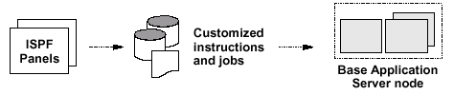

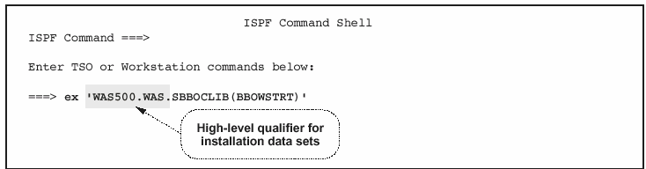
Run customized Jobs to create Base App Server

Slide 28
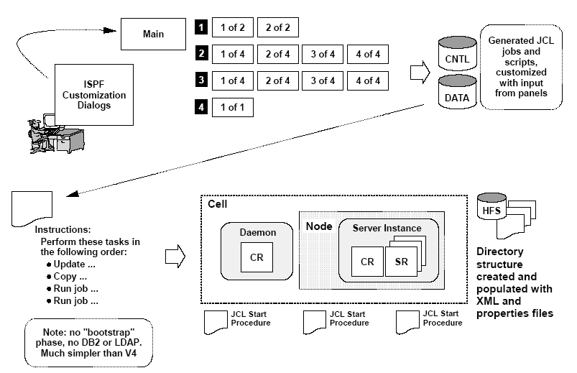
Creating First Base Application Server Node

Slide 29
Base App Server Dialog Main Panel
----------------- WebSphere for z/OS Customization ------------------
Option ===> Appl: GA
Configure base Application Server node
Use this dialog to define WebSphere for z/OS variables and generate
customization jobs for your installation. Specify an option and press ENTER.
HLQ for WebSphere product data sets: WASV5GA
1 Allocate target data sets. The data sets will contain the WebSphere
customization jobs and data generated by the dialog.
2 Define variables. Define your installation-specific information for
WebSphere customization.
3 Generate customization jobs. Validate your customization variables
and generate jobs and instructions.
4 View instructions. View the generated customization instructions.
Options for WebSphere for z/OS Customization Variables
S Save customization variables. Save your WebSphere customization
variables in a data set for later use.
L Load customization variables. Load your WebSphere customization
variables from a data set.

Slide 30
Single copy of JCL for Multiple Servers
//V5ACR PROC ENV=CU1X.NU1.SU1,Z=V5ACRZ
// SET ROOT='/etc/wasv5'
//BBOCTL EXEC PGM=BBOCTL,REGION=0M,
// PARM='TRAP(ON,NOSPIE),ENVAR("_EDC_UMASK_DFLT=007") /'
//BBOENV DD PATH='&ROOT/&ENV/was.env'
// INCLUDE MEMBER=&Z
V5ACR
//*
//* Output DDs
//*
//CEEDUMP DD SYSOUT=*,SPIN=UNALLOC,FREE=CLOSE
//SYSOUT DD SYSOUT=*,SPIN=UNALLOC,FREE=CLOSE
//SYSPRINT DD SYSOUT=*,SPIN=UNALLOC,FREE=CLOSE
//*
//*Steplib Setup
//*
//STEPLIB DD DISP=SHR,DSN=WASV5GA.SBBOLD2
// DD DISP=SHR,DSN=WASV5GA.SBBOLOAD
V5ACRZ

Slide 31

What was Generated by the Dialog?
WASZOS.INSTALL.CNTL (FB)
  Installation Jobs
  Server runtime procedures
  Misc. jobs & utilities
  Instructions
WASZOS.INSTALL.DATA (VB)
  EXECs
  Configuration files
example
BBOCBRAJ BBOCBRAK BBOCTI00 BBODEFR BBODMCCB BBOERRLG BBOINST BBOIPCSP BBOMCFG BBOMCFGU BBOMCFG2 BBOMSGC BBOMSMF BBOPROG BBORRS BBORRSLS
BBOSCHED BBOSSINS BBOTCPIP BBOUNIN BBOWCFRM BBOWCHFS
}
step by step
instructions
Input
members
BBOSSINS
BBOCCINS
BBOWCPY1 BBOWCPY2 BBOWCTR BBOWC2J BBOWC2N BBOWIAPP BBOWIVT BBOWTR BBOW5SH BBO5ACR BBO5ACRZ BBO5ASR BBO5ASRZBBO5DMN BBO5DMNZ
BBOWBMPT
BBOWBOWN
BBOWBRAC
BBOWCEA1
BBOWCOPY
BBOWCPYC
BBOWCPYD
BBOWCPYM
BBOWC2JS
BBOWC2NS
BBOWE2AS
BBOWNODA
BBOWSAAS
BBOWSCMD
BBOWSECA
BBOWSEIA
BBOWSERA
BBOWSOAS
BBOWUUID
BBOWVAA1
BBOWVAA2
BBOWVAA3
BBOWVIHA
BBOWWAPA
*

Slide 32
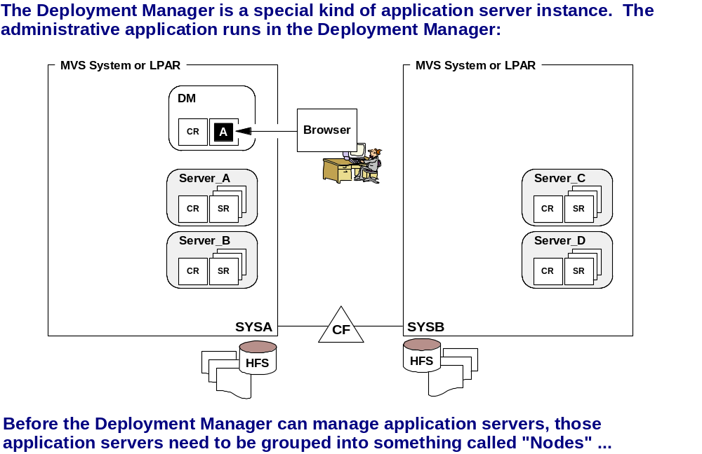
Introducing the Deployment Manager

Slide 33
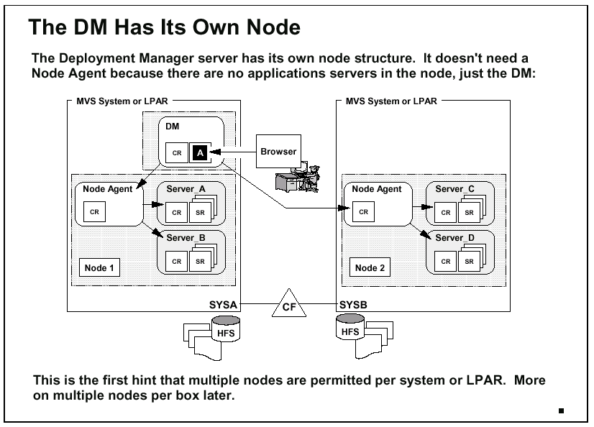
Deployment Manager Node and Address Space Relationship

Slide 34
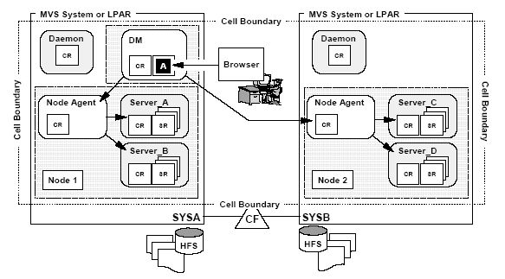
WAS Network Deployment Overview

Slide 35
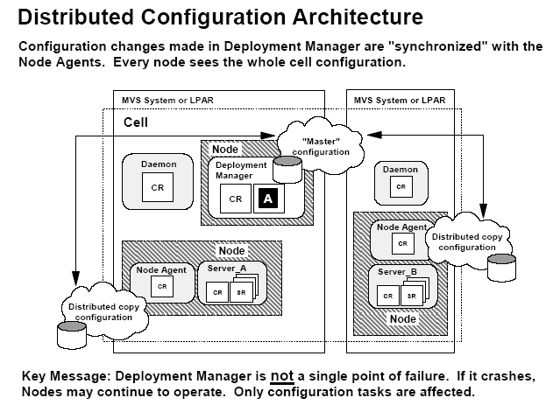

Slide 36
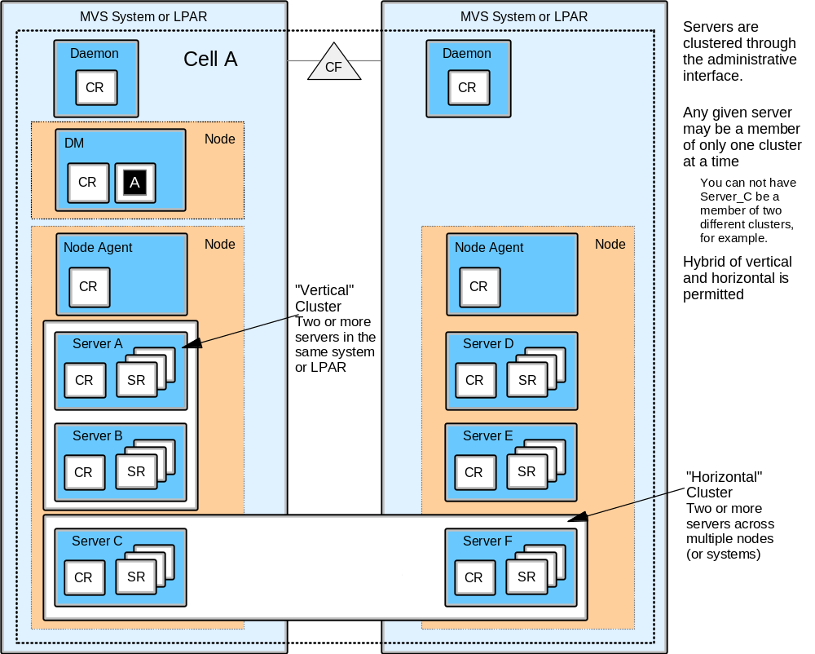
WebSphere on z/OS - continuous availability
Vertical and Horizontal Cluster

Slide 37
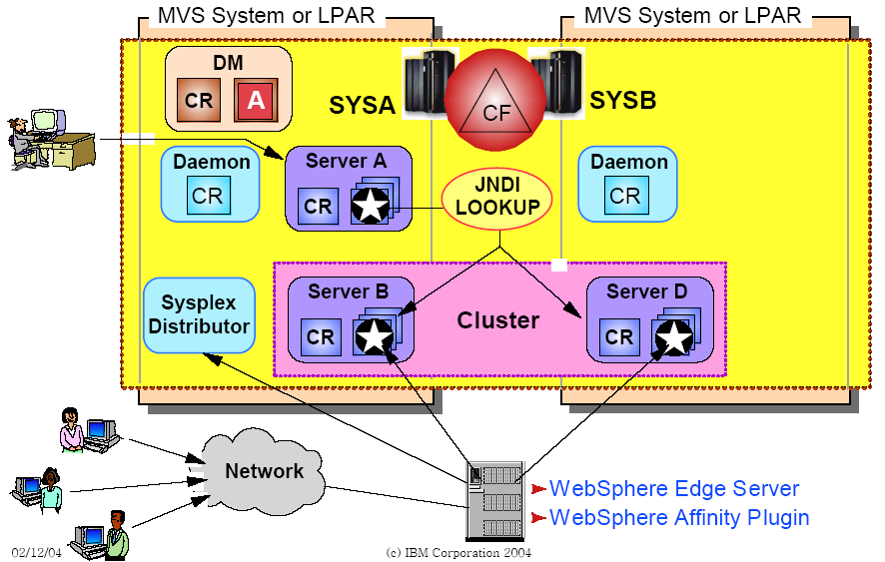
WAS Cluster Load Balancing
Sysplex Distributor

Slide 38
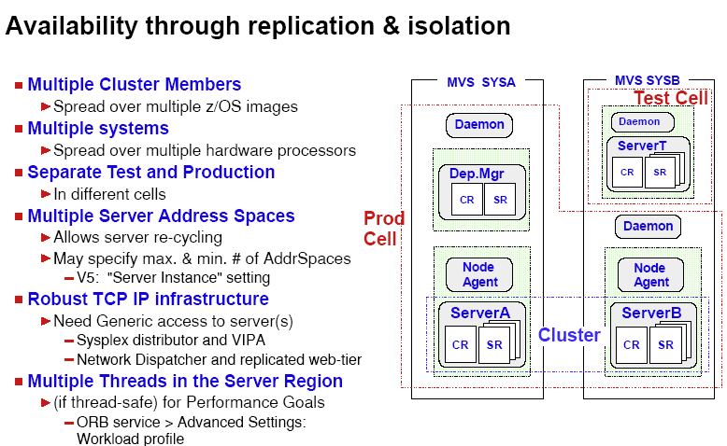

Slide 39
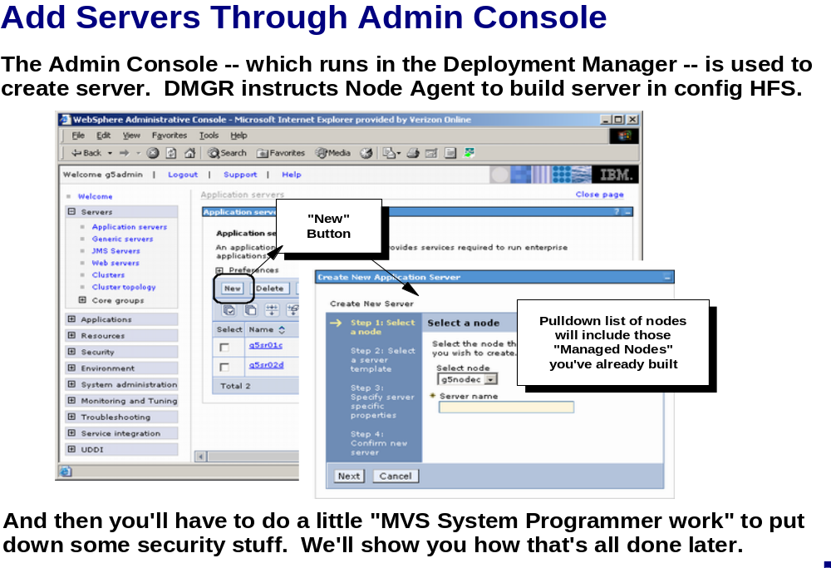

Slide 40
Running WAS on z/OS - Performance
WebSphere uses three distinct functions of WLM:
Routing
Queuing
Prioritizing

Slide 41
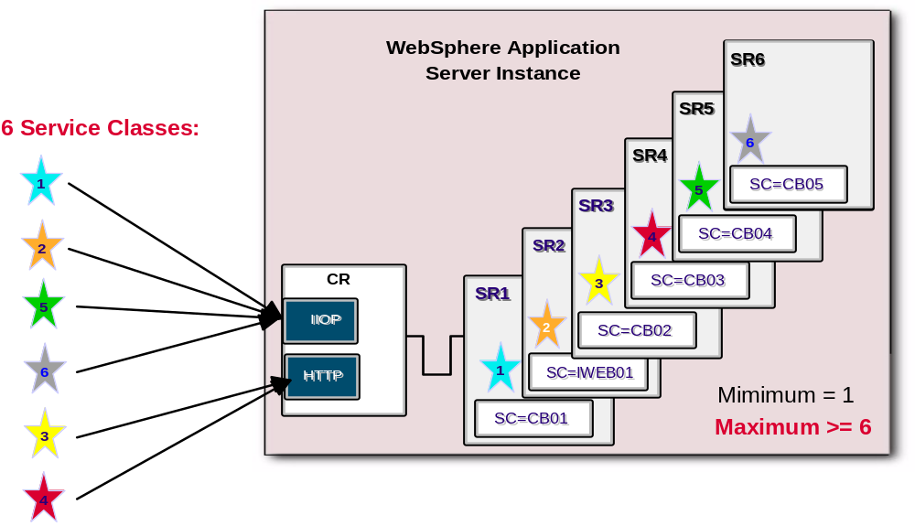
Why WLM . . .
example

Slide 42
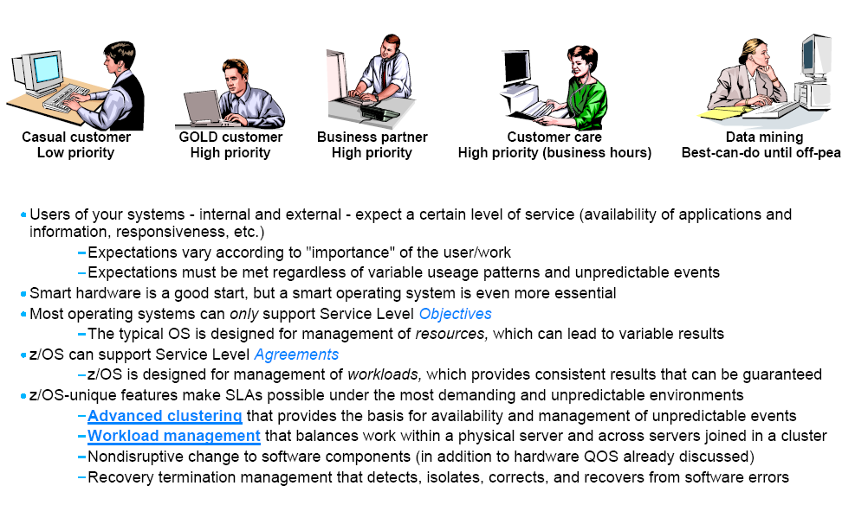
Establish Service Level Objectives for different departments

Slide 43
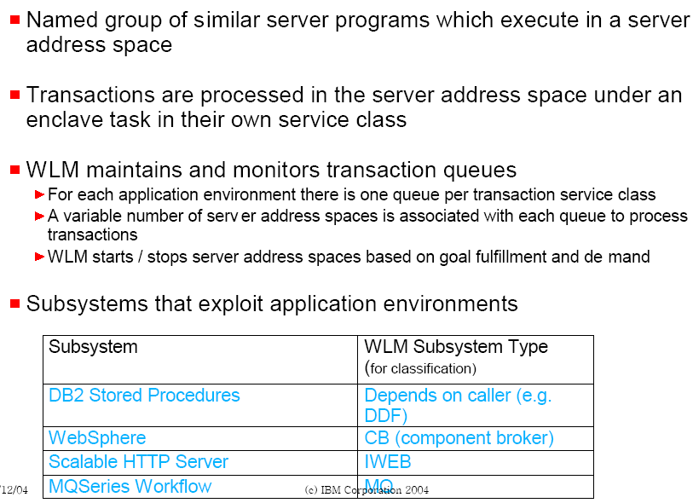
Application Environments

Slide 44
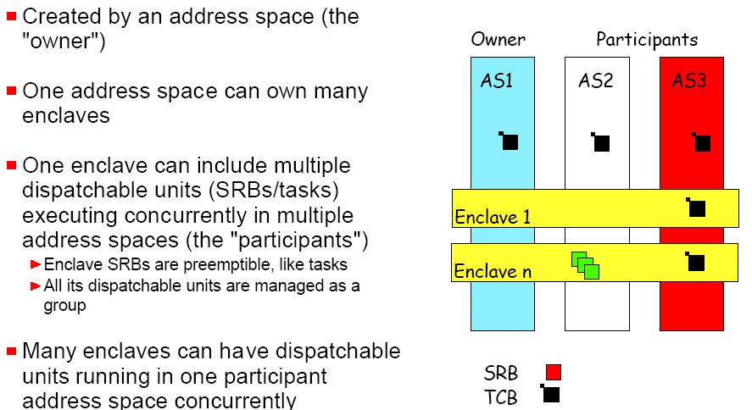
WAS’ Enclave Characteristics

Slide 45
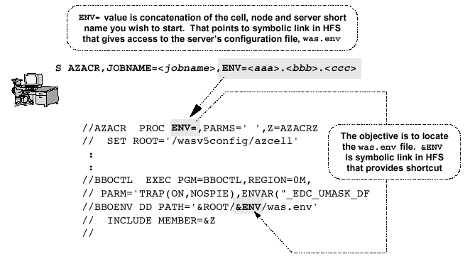
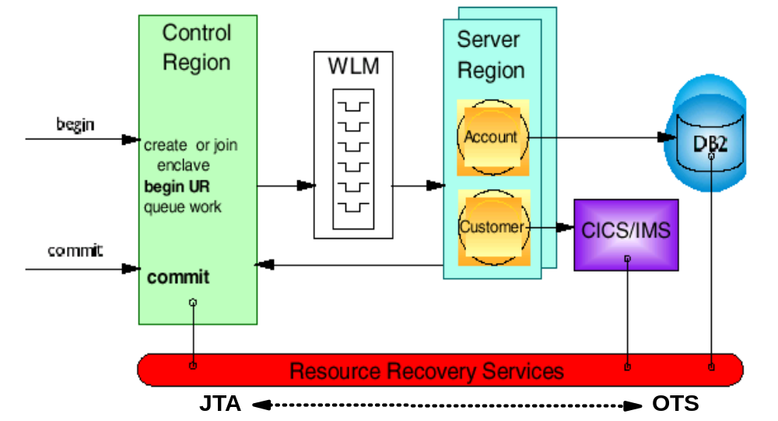
Sample J C L

Slide 46
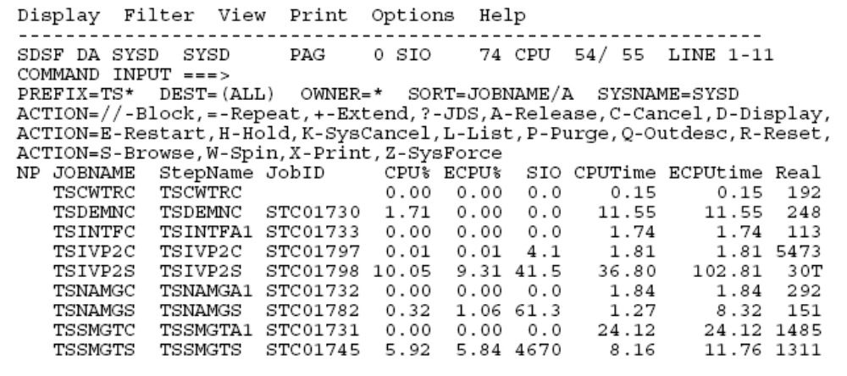
SDSF display ‘DA’

Slide 47
Websphere - R R S / XA
OTS is the Object Transaction Service
Provides the framework to run transactions on a single server, or across
multiple servers.
- It is designed to be interoperable with other OTS components.
- Provides very few applicaion level APIs accessible from J2EE components.
- Our OTS implementation is z/OS specific and lives entirely in native code.
For more details about what OTS is, see the 3.x and 4.x STE resentations.
JTA is the Java Transaction API
- For WebSphere on z/OS, JTA sits "on top of" OTS.
It is part of the J2EE specification, and as a result, supports the UserTransaction
API for J2EE applications, and other SPIs used by the EJB Container.
Since JTA is java-specific, our java implementation lives mostly in java.
JTA is modeled on the XA Specification
XA is an X/Open Group specification which describes how a resource should
communicate with a transaction manager. It's standardized through ISO.
- JTA includes a mapping of the XA specification (but not a full mapping).
XA support is new for z/OS in 5.0
RRS is a z/OS specific transaction manager
- RRS can be though of as an entity which manages resources in a z/OS-specific way.
RRS does not support the XA protocol, but does share some similarities which allow us
to merge both RRS and XA resources together in the same transaction.
Overview

Slide 48
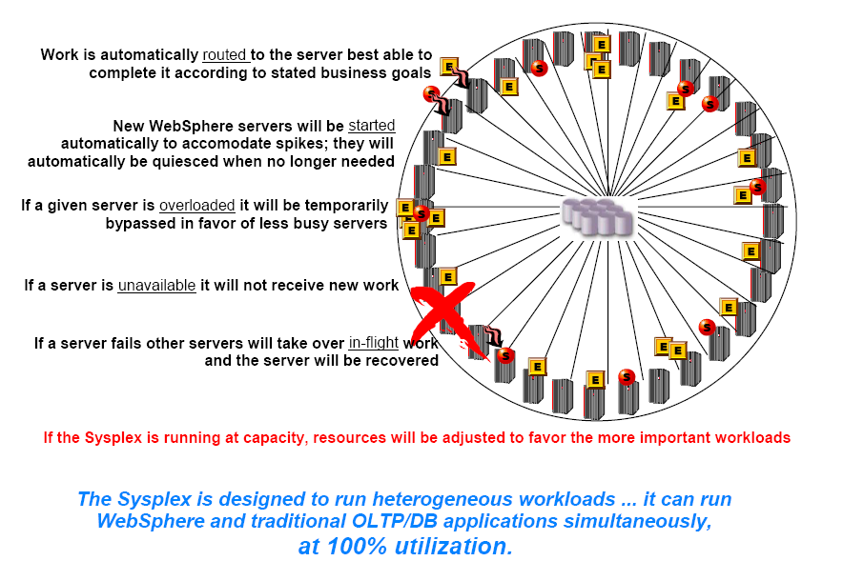
Intelligent Workload Management

Slide 49
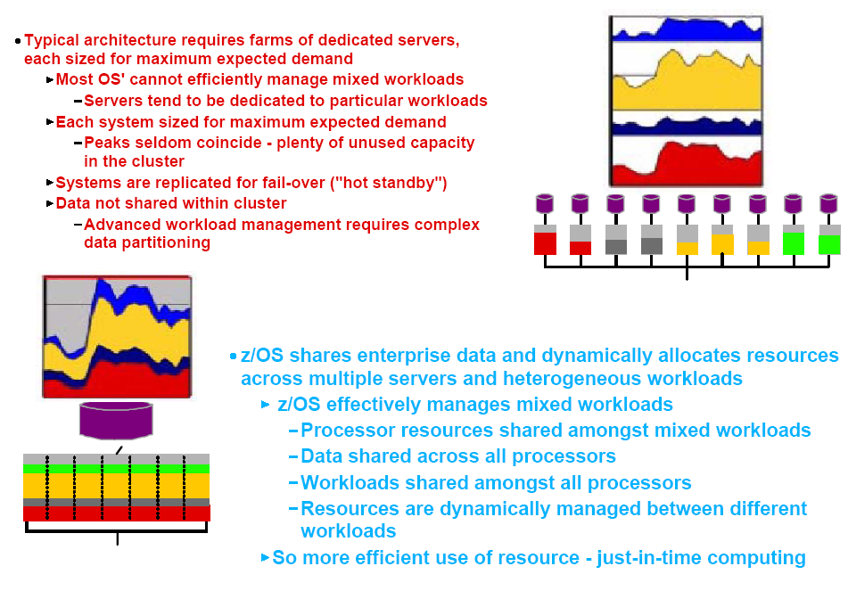
zSeries Differentiation with WAS on Z

Slide 50
Web Servers in v6
Web servers can now be defined in a WebSphere Application
Server topology
Allows association of the application to one or more defined Web servers
  This allows generation of custom plug-in configuration files for a specific
  Web server
Allows administration of the web server via the admin console

Slide 51
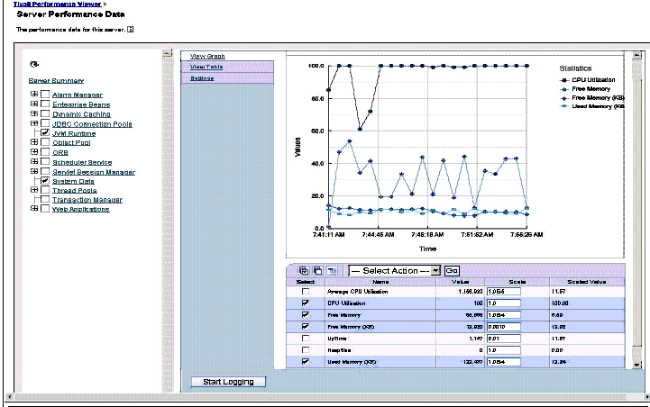
Integrated Performance Viewer

Slide 52
wsadmin: How does it work?
wsadmin acts as an interface to MBeans (JMX management objects)
Objects perform different operations
  AdminConfig
  AdminApp
  AdminControl
  AdminTask
  Help
Separation between
Configuration and
Control
MBean
AdminTask
MBean
AdminApp
AdminConfig
MBean
Script
Script
wsadmin
AdminControl
Help
MBean
MBean

Slide 53
wsadmin Examples
Installing an application
  Using jacl
    wsadmin.sh –c “$AdminApp install /tmp/MyApp.ear {-appname MyApp}”
  Using Jython
    wsadmin.sh –lang jython –c “$AdminApp.install (‘/tmp/MyApp.ear’,’ [-appname MyApp]’ )”
Running scripts
  Running a jacl script
    wsadmin.sh –f appinst.jacl
  Running a jython script
    wsadmin.sh –lang jython –f appinst.py

Slide 54
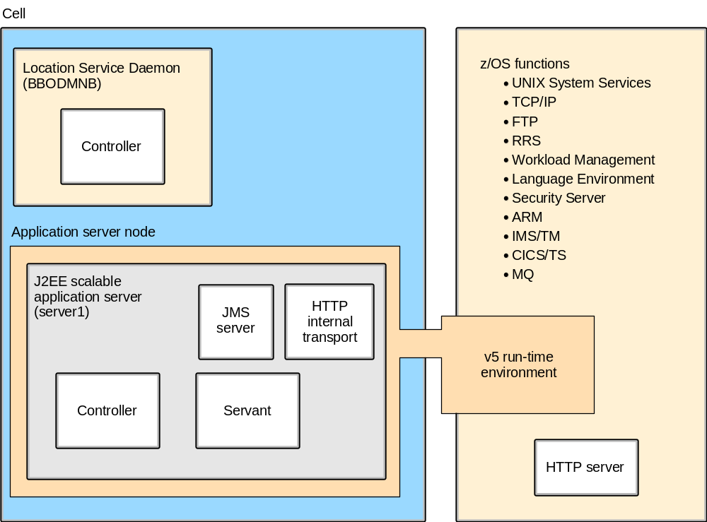
Application Server Configuration on z/OS
Base Server Node

Slide 55
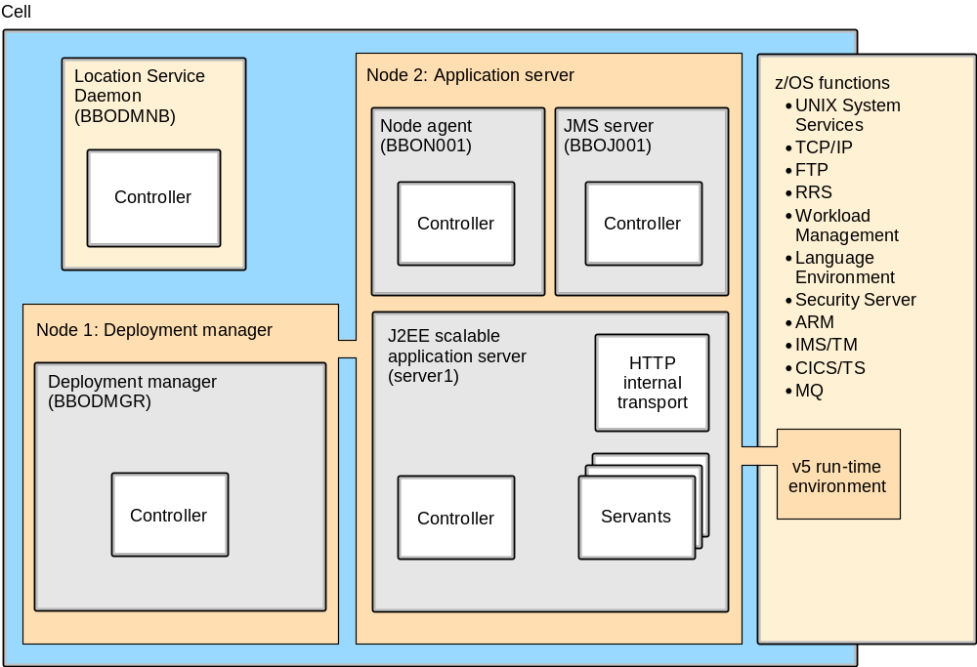
Application Server Configuration on z/OS
Network Deployment Manager

Slide 56
Connectors for Enterprise Information Systems
Some considerations:
Expensive
Must be secured
Need to perform well
Must be monitorable
Methods needed
Quality of devices

Slide 57
Mainframe Connectors
CICS Transaction Gateway
IMS Connect
DB2 JDBC

Slide 58
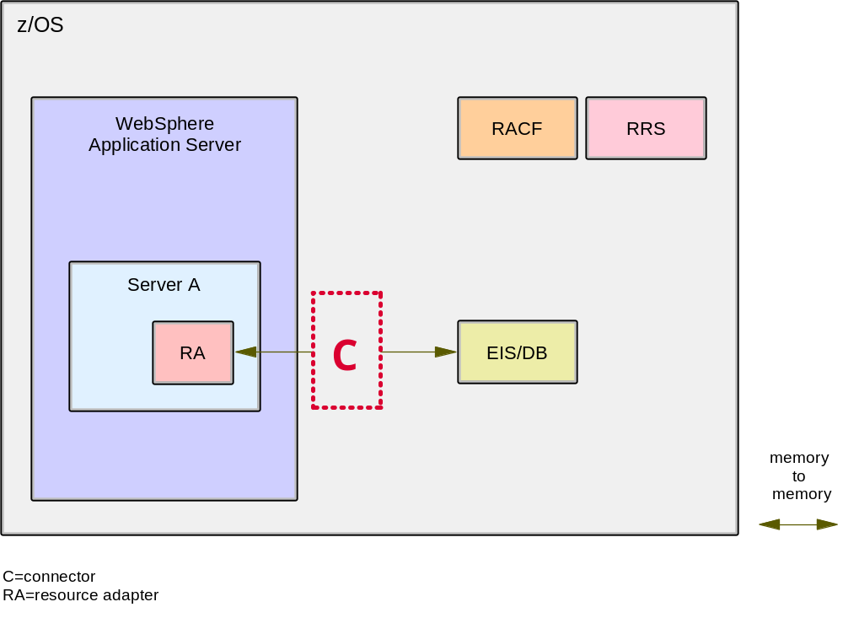
Basic Architecture of an connector to an EIS

Slide 59
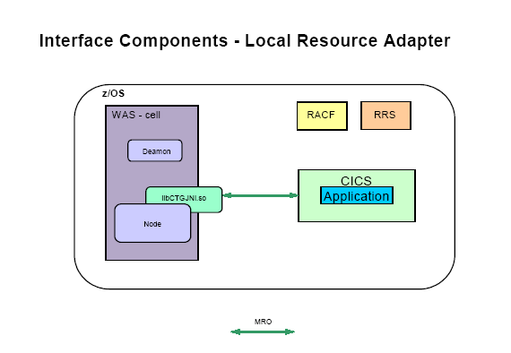

Slide 60
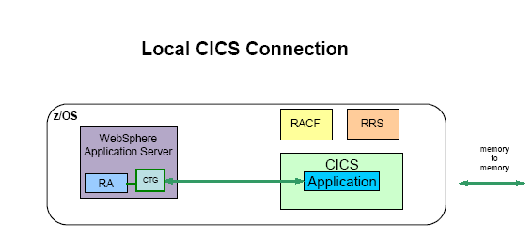

Slide 61
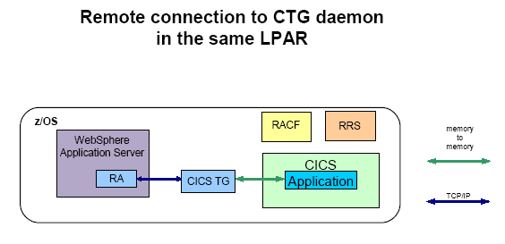

Slide 62
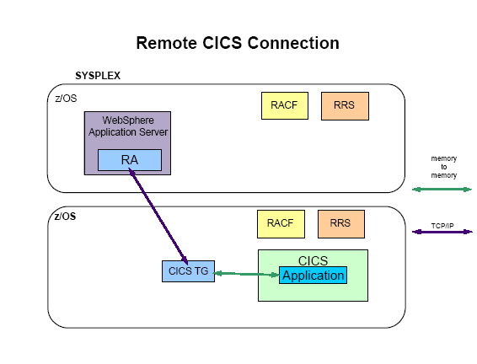

Slide 63
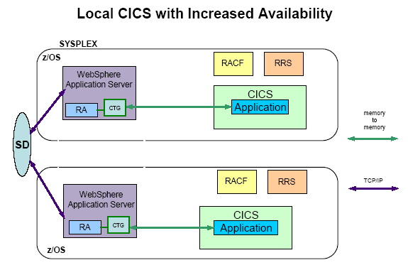

Slide 64
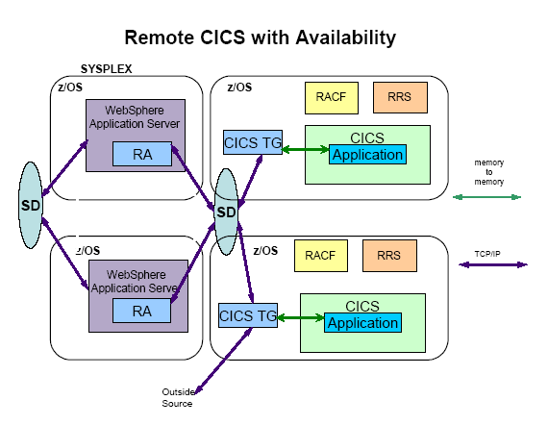

Slide 65
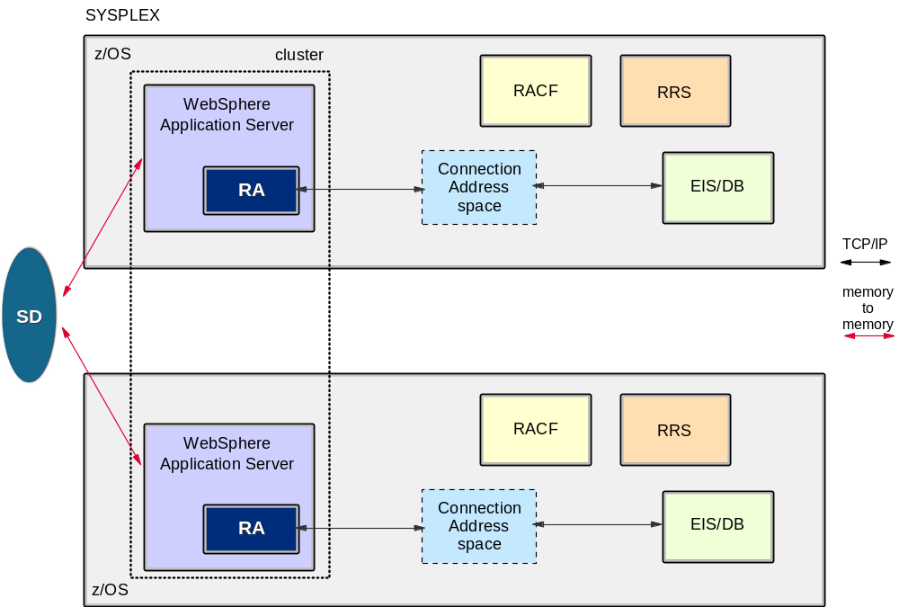
WebSphere on z/OS - continuous availability
WebSphere with Sysplex Distributor

Slide 66


Slide 67


Slide 68


Slide 69

JDBC Drivers

Slide 70

JDBC Drivers for zOS

Slide 71

Connectivity for a Local DB2

Slide 72

Connectivity for a Remote DB2

Slide 73

Local T2 Connection / Remote T4 Connection

Slide 74

Connectivity Options

Slide 75

VSAM Connector for z/OS Puts VSAM Data into the WebSphere Picture

Slide 76


Slide 77


Slide 78


Slide 79


Slide 80
Summary
In this chapter, you learned to:
  List the six qualities of the J2EE Application model
  List three reasons for running WebSphere Application Server under z/OS
  Name three connectors to CICS, DB2, and IMS

